Slide 1
The Battle of Neighborhoods

Slide 2
Data
We were given 3 specific cities closed to the Airport to investigate (Atlanta, Decatur and Kennesaw), and then select the best place for our Dominican Restaurant.
First, I used Foresquare API to collect the venues within 10 miles of each city center.
Second, I filtered the results and collected just the restaurants found within 10 miles of each city center.
Third I performed a search to make sure there were no other Dominican restaurants in the area.
Finally, I generated a plot with each restaurant found in each city center, to have a visual of how close are these restaurants to each other, this will give us an overview of the data that we're working with to find the best city to place our Dominican Restaurant.

Slide 3
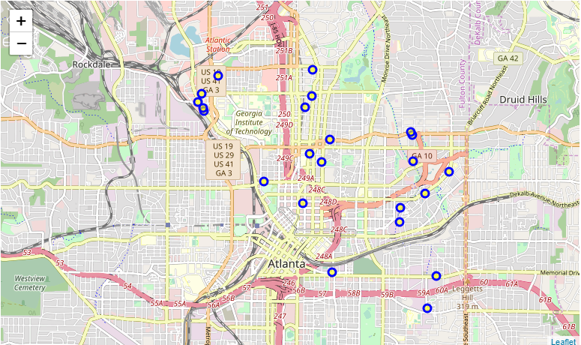
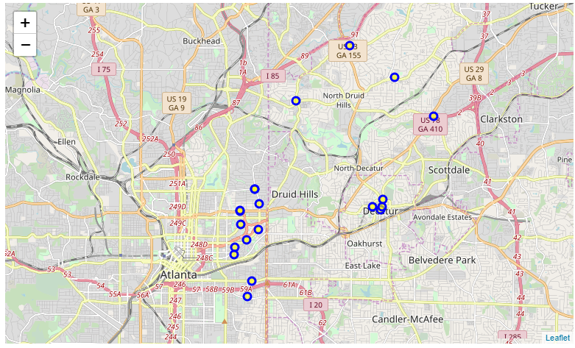
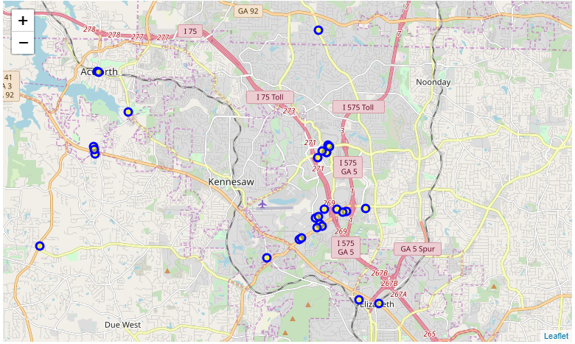
Restaurant’s Distribution
Atlanta
Decatur
Kennesaw

Slide 4
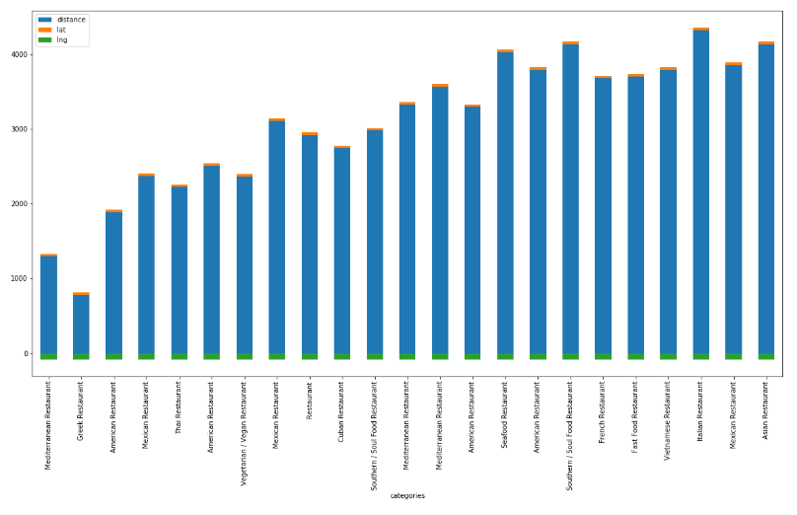
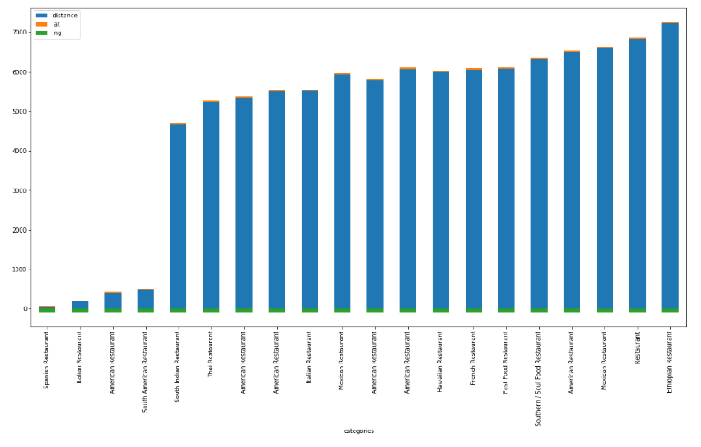
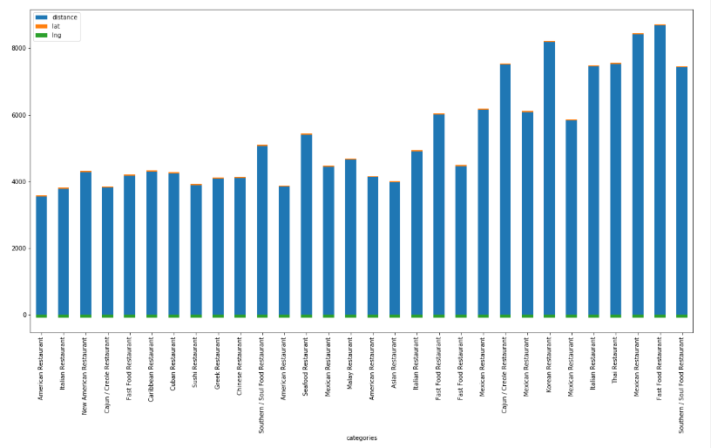
Restaurant’s Distance from city center
Atlanta
Decatur
Kennesaw

Slide 5
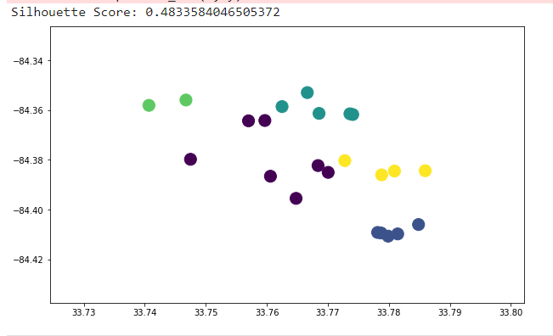
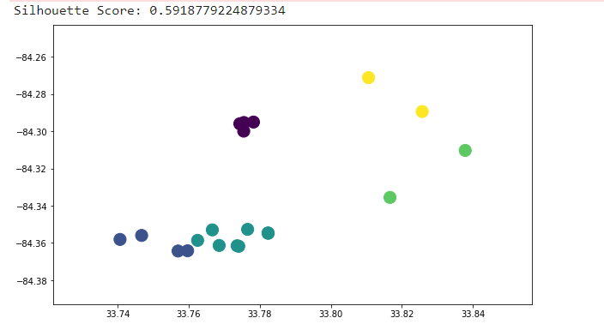
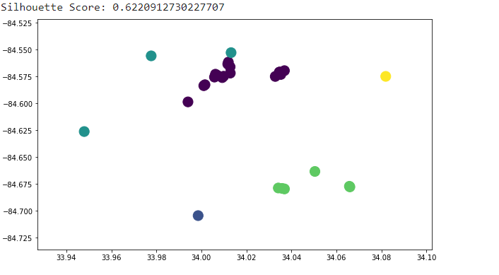
Restaurant’s Clusters by Distance
Atlanta
Decatur
Kennesaw

Slide 6
Conclusion
In conclusion, due to the probabilities of getting new customers, the good place within walking distance from other restaurants, the variety of restaurants, which could decide that in this city we might see a big variety of customers with different likes that might be interested in trying food from the Dominican Restaurant, taking in consideration that it will be the first restaurant offering this type of food in the area, and the fact that is the closes city to the Airport, in conclusion, Atlanta is the best city from the 3 cities provided by our Stakeholder, if she wants to open a Dominican restaurant in Georgia.

